Slide 1
Context Sensitive Systems – Introduction to Context Recognition

Slide 2
Content of this lecture
Context and Motivation
Sensors and Middleware
/ 8. Features in Data
/ 9. Prediction
/ 10. Classification
Vertical Application
Fusing Knowledge
Context oriented Programming

Slide 3
Definition transducer
A transducer is a device that converts one form of energy to another form of energy. Energy types include/(but are not limited to) electrical, mechanical, electromagnetic (including light), chemical, acoustic, and thermal energy. (for example, a loudspeaker converts an electric signal to sound),
A sensor is a transducer whose purpose is to sense (that is, to detect) some characteristic of its environs. A sensor is used to detect a parameter in one form and report it in another form of energy, often an electrical signal.

Slide 4
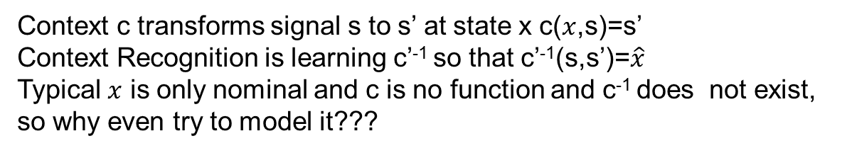

Sensor and Context
Context c transforms signal s to s’ at state x c($x$,s)=s’
Context Recognition is learning c’⁻¹ so that c’⁻¹(s,s’)=$\hat{x}$
Typical $x$ is only nominal and c is no function and c⁻¹ does not exist, so why even try to model it???
Context c with hidden state
Sensor
Beacon/ Reflector
$$x$$
External Energy Source

Slide 5
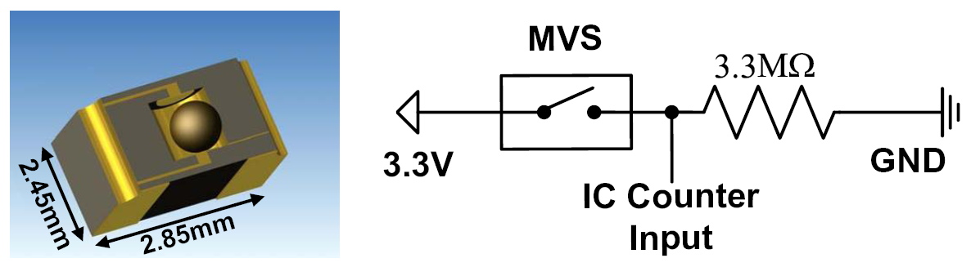
Unconventional Sensors
Undertanding the sensor becomes important!
Notes:
This context awareness and novel form of HCI is based on sensors.
What we used in the Retail Store Application are special types of sensors as the one you see here, that is a extreme high sensitive movement sensor system with almost 0 energy consumption that we develop togehter with Prof. Weber from the IPE (Institut für Prozessdatenverarbeitung und Elektronik) from the Helmholtz Part.
Now we have sensors and we want to build context aware systems out of it. How do we do this?

Slide 6

Detection Chain
Ubicomp: Assignments correlated / learned
Activity
Physical Pheno-menon
Detection
Classification
Activity
Classical Measurement methods: Each step analytically modelled
Phenomenon
(e.g. Context Value)
Activity
Physical Pheno-menon
Detection
Feature Extraction & Reduction
Normalization
Classification
Reasoning
Activity

Slide 7
Measurement in the 21st century
„A set of observations that reduce uncertainty where the result is expressed as a quantity” Douglas Hubbard: "How to Measure Anything", Wiley (2007)
Result of a measurement: value, mean, other statistical values e.g. standard deviation
In this sense, a good guess may not be worse than a bad measurement

Slide 8
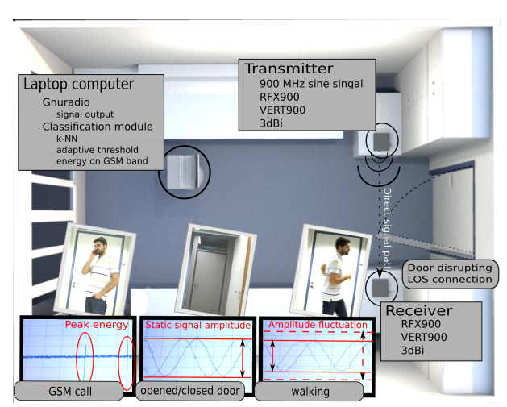
Activity Recognition Using RF Signals

Slide 9
Middleware

Slide 10


Communication and Context
Sensor
Sensor
Sensor
$$x$$
$$x$$
Sensor Node
Analytics Node
What is the main role of context in communication?
What type of context is relevant here?

Slide 11
Interoperability
In order to interoperate, two entities must have some shared agreement on the form and function of their communication (→could be seen as pre-shared context)
The agreement defines the interfaces each entity exports, and which are known to the other party
e.g. a web browser and a web server must agree on a set of common protocols (HTTP) as well as format and semantics of data exchanged (usually HTML, XML)
Web services and their clients must agree upon known service interfaces and protocols for their invocation
The agreement must be a priori, and built-in to each party
→ Cognitive aspects (context recognition) typically can only optimize

Slide 12
How to connect your sensor
20mA
I²C
SPI
MBUS
…

Slide 13
List of M2M Protocols (source: Wikipedia)
AS-i – Actuator-sensor interface, a low level 2-wire bus establishing power and communications to basic digital and analog devices
BSAP – Bristol Standard Asynchronous Protocol, developed by Bristol Babcock Inc.
CC-Link Industrial Networks – Supported by the CLPA
CIP (Common Industrial Protocol) – can be treated as application layer common to DeviceNet, CompoNet, ControlNet and EtherNet/IP
Controller Area Network utilised in many network implementations, including CANopen and DeviceNet
ControlNet – an implementation of CIP, originally by Allen-Bradley
DeviceNet – an implementation of CIP, originally by Allen-Bradley
DF-1 - used by Allen-Bradley PLC-5, SLC-500, and MicroLogix class devices
DirectNet – Koyo / Automation Direct^{[1]} proprietary, yet documented PLC interface
EtherCAT
Ethernet Global Data (EGD) – GE Fanuc PLCs (see also SRTP)
EtherNet/IP – IP stands for "Industrial Protocol". An implementation of CIP, originally created by Rockwell Automation
Ethernet Powerlink – an open protocol managed by the Ethernet POWERLINK Standardization Group (EPSG).
FINS, Omron's protocol for communication over several networks, including ethernet.
FOUNDATION fieldbus – H1 & HSE
HART Protocol
HostLink Protocol, Omron's protocol for communication over serial links.
Interbus, Phoenix Contact's protocol for communication over serial links, now part of PROFINET IO
MACRO Fieldbus - "Motion and Control Ring Optical" developed by Delta Tau Data Systems.
MECHATROLINK – open protocol originally developed by Yaskawa, supported by the MMA
MelsecNet, supported by Mitsubishi Electric.
Modbus PEMEX
Modbus Plus
Modbus RTU or ASCII or TCP
OSGP – The Open Smart Grid Protocol, a widely use protocol for smart grid devices built on ISO/IEC 14908.1
OpenADR – Open Automated Demand Response; protocol to manage electricity consuming/controlling devices
Optomux – Serial (RS-422/485) network protocol originally developed by Opto 22 in 1982. The protocol was openly documented^{[2]} and over time used for industrial automation applications.
PieP – An Open Fieldbus Protocol
Profibus – by PROFIBUS International.
PROFINET IO
RAPIEnet – Real-time Automation Protocols for Industrial Ethernet
Honeywell SDS – Smart Distributed System – Originally developed by Honeywell. Currently supported by Holjeron.
SERCOS III, Ethernet-based version of SERCOS real-time interface standard
SERCOS interface, Open Protocol for hard real-time control of motion and I/O
SSCNET, Servo System Controller Network by Mitsubishi Electric for control of motion and I/O
GE SRTP – GE Fanuc PLCs
Sinec H1 – Siemens
SynqNet – Danaher
TTEthernet – TTTech
MPI – Multi Point Interface

Slide 14
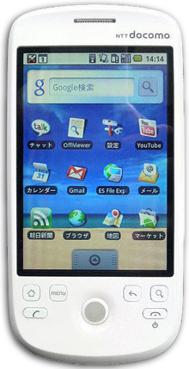
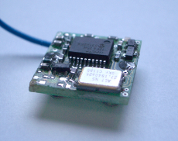
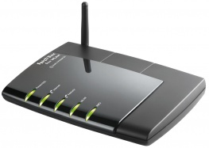
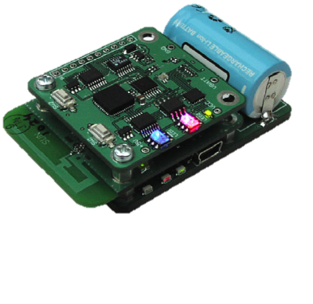
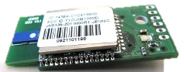
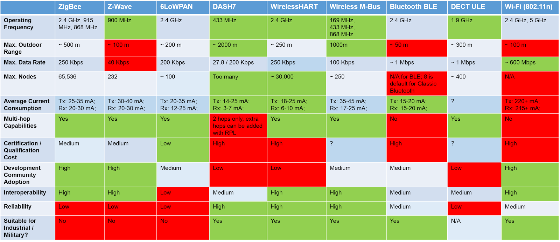
Sensor Connectivity: Wireless Protocols

Slide 15
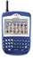
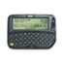


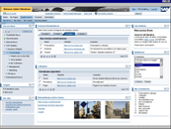

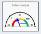






Internet of Things and Services
Devices
People
roles
embedded analytics
collaboration
roles
User Presentation
alerts
A2A
B2B
Information
&Analytisc
Services
Leg- acy
SCM
ERP
PLM
EHM
SRM
CRM
PLM
IoT Network
Smart Items
Middleware & Transcoders
Physical World / Things

Slide 16

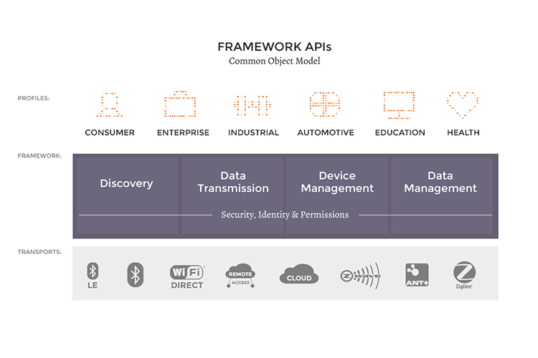














Example: Linux Foundation IoTivity

Slide 17
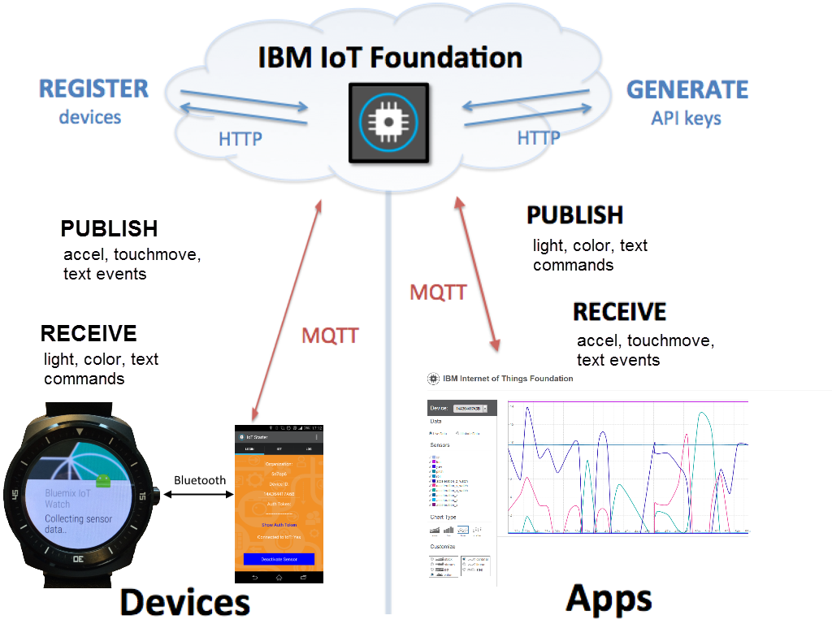
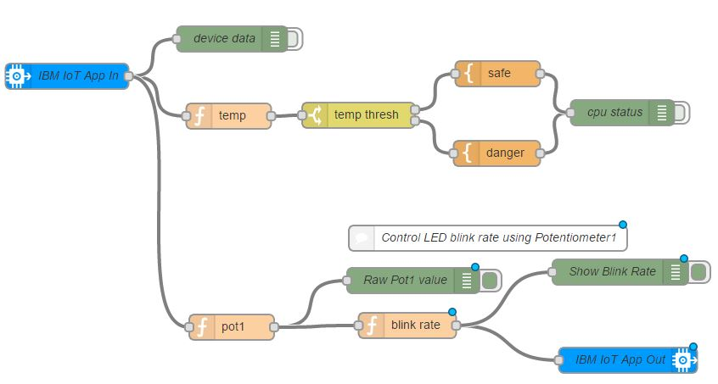
Example IBM IoT Foundations
IBM bluemix based
MQTT as Communication Middleware

Slide 18
Common Pattern: Pub Sub
Producer
publish(topic, msg)
Consumer
subscribe
Topic 1
Topic 2
msg
Topic 3
Publish subscribe
system
Consumer
Producer
msg
Notes:
Multiple subscribers, decoupling
Some examples : email notification on adding connection etc

Slide 19











Example: Hadoop Architecture
VISUALIZE
INGEST
PROCESS
STORE
ANALYZE

Slide 20
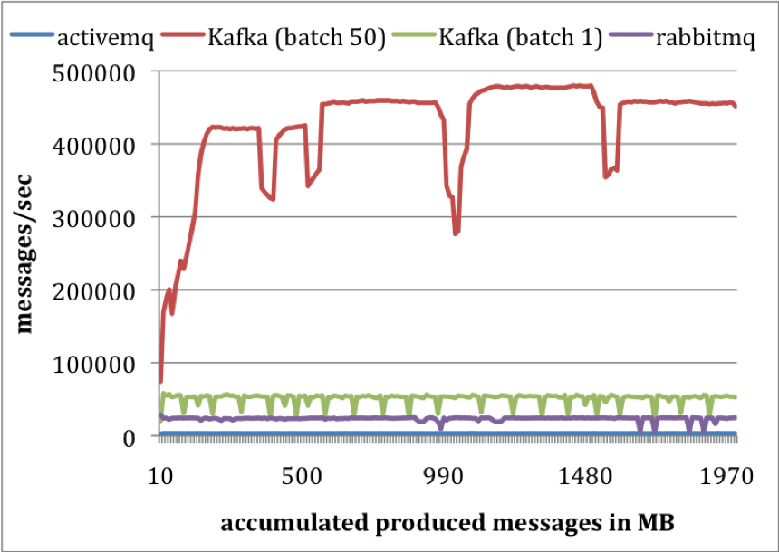
Scaling Messaging
Notes:
single producer to send 10 million messages, 200 bytes each.
single consumer thread
Flush interval 10K
ActiveMQ – syncOnWrite=false, KahaDB
RabbitMQ – mandatory=true, immediate=false, file persistence
the producer throughput in messages/secondKafka produces at the rate of 50K / second with batch size of 1
400K / second with batch size of 50.
These numbers are orders of magnitude higher than that of ActiveMQ and at least twice better than RabbitMQ.
No producer ACKS
more compact storage format
9 bytes/message overhead in Kafka
144 bytes/message overhead in ActiveMQ
Cost of maintaining heavy index structures
One thread in ActiveMQ spent most of its time accessing a B-Tree to maintain message metadata and state

Slide 21
The real challenge: non-scalable integration
The Combinatorial Complexity of Ongoing Integration
For interoperability, devices have to be programmed to recognize the specific protocols, standards, data formats, and operations of all expected peer devices
If we want to integrate a new device type into a network, all existing devices must be updated
Because developers program against standards known at development time, they can’t accommodate entirely new devices that don’t resemble existing standards

Slide 22
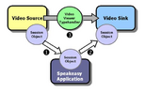
The 1990s: “Recombinant Computing” (PARC Object Infrastructure, formerly known as Speakeasy)
A small, fixed set of generic interfaces
presumed to be known to all parties in an interaction
Mobile code for dynamic extension
sender downloading code to clients for specific protocols, data types
User in the loop
Decides which devices/service to associate
Programmatic interfaces define only syntax, user must decide what makes sense

Slide 23
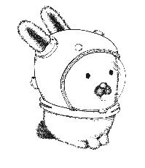
The 2000s: Namespaces Mobile Users
Interact with local resources
Data cloud follows the user
move
Space A
Space B
→ inject personal data reference into local space
Building Applications for Ubiquitous Computing Environments.
Christopher K. Hess, Manuel Román, and Roy H. Campbell, In International Conference on Pervasive Computing (Pervasive 2002), Zurich, Switzerland, August 26-28, 2002.

Slide 24
Two big problems of mobility
Physical Mobility
Devices move around
Logical Mobility
Functionality moves around
In context-aware systems both can make a difference
Slightly different understanding of middleware in terms of transparency

Slide 25
Service oriented Computing: Set of Reusable Components
Connected Device Services
WS-Eventing
WS-Transfer
WS-MEX
WS-Discovery
WS-Addressing
SOAP 1.2
HTTP
SOAP over UDP
Devices Profile for Web Services

Slide 27
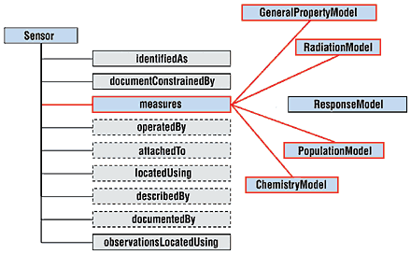
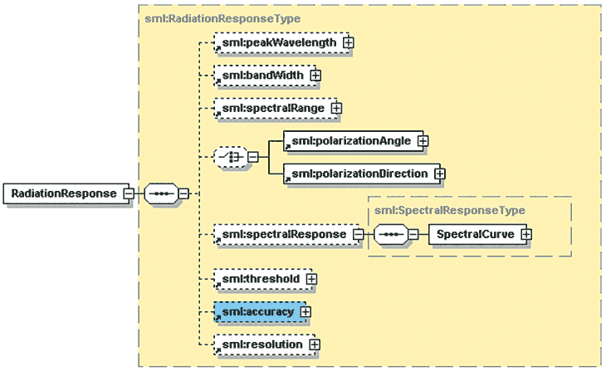
Ontologies to describe sensors and measurements

Slide 28
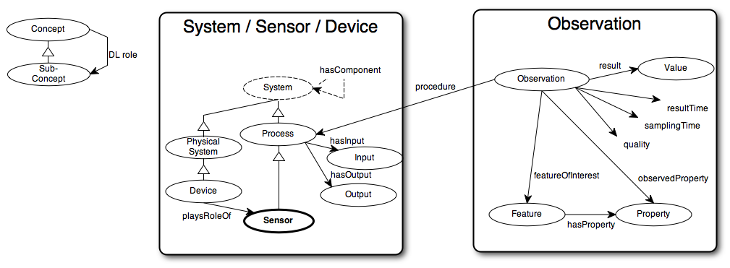
and sensor networks
SSN Ontology: Sensor is-a Process is-a System

Slide 29
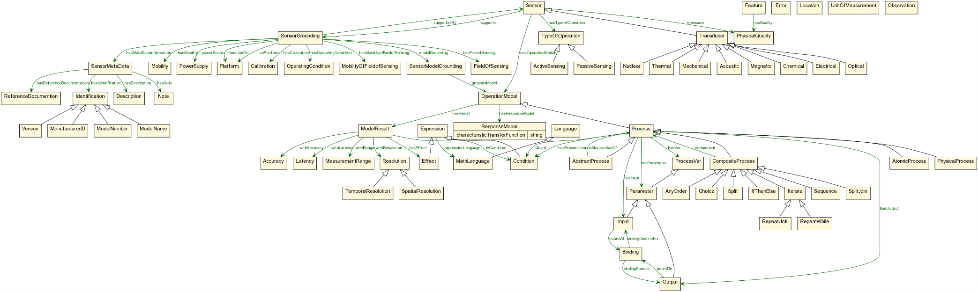
CISRO Sensor Ontology

Slide 30
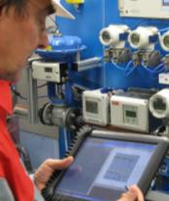
Interoperability w/ code generation
Networks:
869MHz AwareCon
300/869MHz µPart
2.4Ghz 6lowpan
2.4Hz 802.15.4 Proprietär
SOA:
DPWS
Programming Language:
C, C#, Java
SW Plattforms:
Contiki, ParticleOS, Linux/BSD Sockets
HW Plattform:
Pic18F, AR7
OpenRISC,x86
APIs:
Plain C DOM, WCF 4, WS4D
DPWS Gateway-Architektur for industrial Service
High level of code reuse by aspect oriented code generation using XPAND

Slide 31
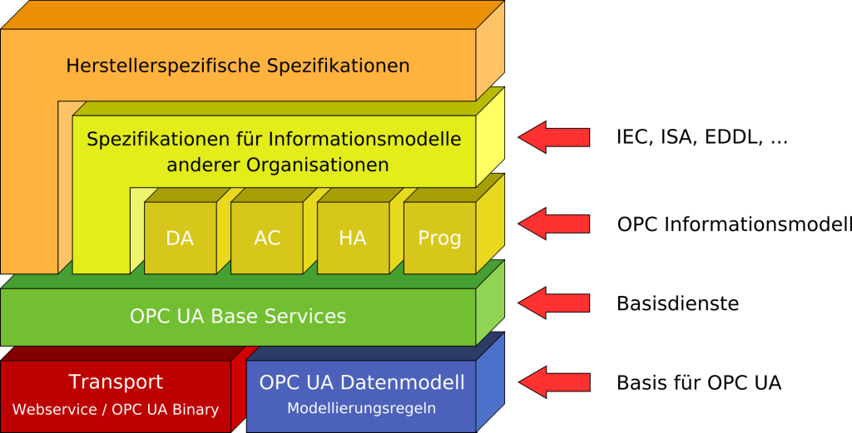
OPC - UA

Slide 32
Socrades: Enterprise Applications

Slide 33
Protokolle!
MQTT
REST/JSON HTTP, WebSockets/WebRTC (??)
6LowPAN/COAP (also via BT4)
XMPP
HTTP/2 w/ header compression, QUIC (MTU to small??)
OPC-UA, MTConnect
Markus Jung, Samsung, IoT 2015

Slide 34
2010s: Web of Things

Slide 35
The Semantic Web Dream
“The semantic web is a vision of information that is understandable by computers, so computers can perform more of the tedious work involved in finding, combining, and acting upon information on the web.” – Wikipedia
“I have a dream for the Web [in which computers] become capable of analyzing all the data on the Web – the content, links, and transactions between people and computers.”
– Tim Berners-Lee

Slide 36

Web of Things Framework

Slide 37
Classical Pattern Recognition
Data come from a transducer
Feature extraction compresses, filters, transcodes, prepares sensor data
Classification interprets features and assigns a class for them (Knowledge required!)
Further abstraction may be added: high level information, reasoning
Sensor
Data
Class
Feature
Extraction & Reduction
Features
Detection (Transducer)
Further Abstraction
Classification
...
...

Slide 38
Complexity of Recognizing Contexts 2
Complex contexts can only be sensed indirectly
Context affects environment in various ways
Sensors sample specific parameters of the same environment
Context is present in the sensor signal streams
Problems:
Sensors only sense partial effects of context
Sensors are noisy
Different types of the same context may affect sensor signals in different ways

Slide 39
Context Recognition using Expert Systems
Create program logic to recognize contexts
IF location==N. Campus || S. Campus THEN
context := University;
Advantages:
often correctly recognizes context using expert knowledge
Problems:
Designer must have in-depth knowledge of how context classes affect parameters measure by sensors
Recognition limited by development time
Example: recognize the difference between “walking” and “climbing stairs”
IF ????? THEN
Solution: allow devices to learn difference!

Slide 40
Machine Learning for Context Recognition
Devices learn to differentiate between context classes
Idea:
devices experience different contexts through sensors
Use this experience to learn the difference between
(Compare: expert’s experience)
Learning results in executable model:
Sensor signals as input
Context as output
IF [[learned parameters]] THEN
context := University;
Process AKA: pattern matching, pattern recognition, classification
Disadvantages:
Labeled sensor data must be collected
NO SIMPLE TASK!
Classifier can become complex
Algorithms require time and resources for learning

Slide 41
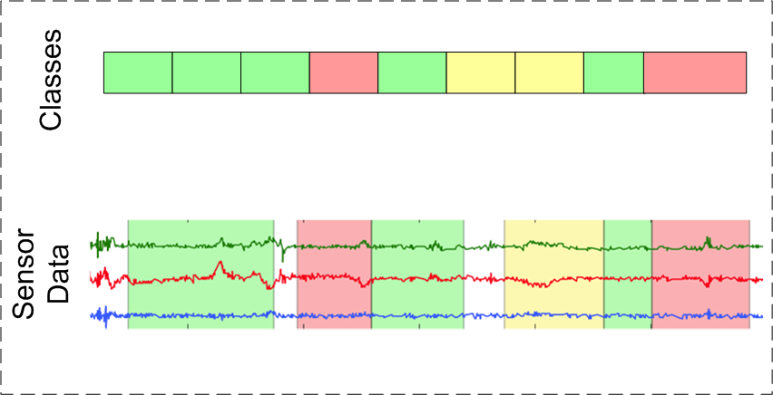
The Learning process
Learning based on:
sensor data history
annotated context history: “labels”
Learn to recognize correlated sensor signal patterns and contexts
(supervised learning)
Training is “offline”

Slide 42
Supervised Machine Learning
Supervised learning
Set of training data:
Feature vectors , and labels
Features calculated at end of each sample window, resulting in vector
Vector is classified by classification algorithm, resulting in context label

Slide 43
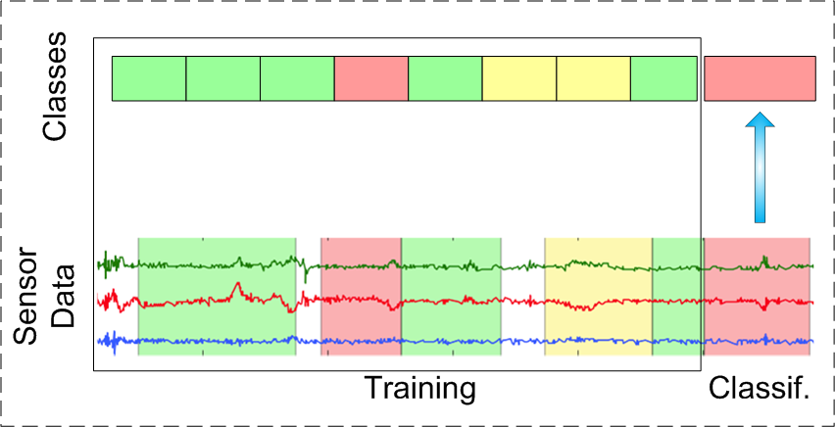
The Classification Process
Trained executable object results from learning process
Black box: analog sensor input, discrete symbolic context as output
Level of abstraction increases, trend from numeric, high-volume data (0x3F, 2°C), to symbolic, low-volume context (“walking”, “busy”)

Slide 44
Data Processing

Slide 45
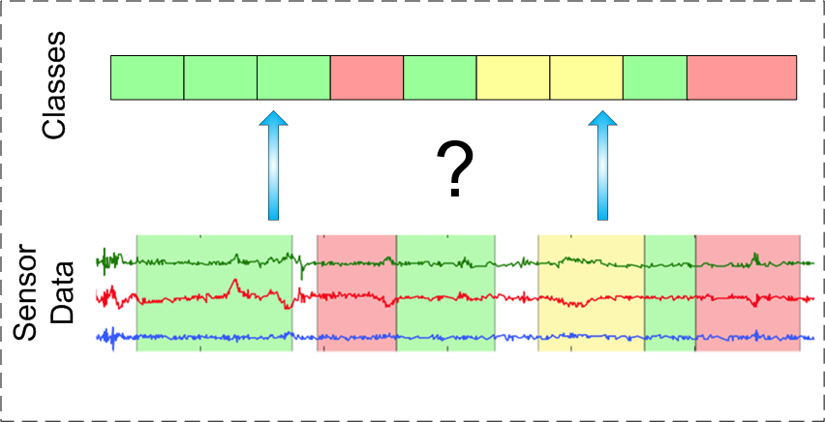
Data Processing Chain
Problem:
Input: often analog, continuous sensor signals
Output: symbolic, discrete context class
How do we get from one to the other?
Sampling sensors yields discrete measurements
High volume, depending on sampling rate
In theory, sensor data as direct input to classifier
Greatly increases classifier complexity – too much information!
Solution: extract information of importance

Slide 46
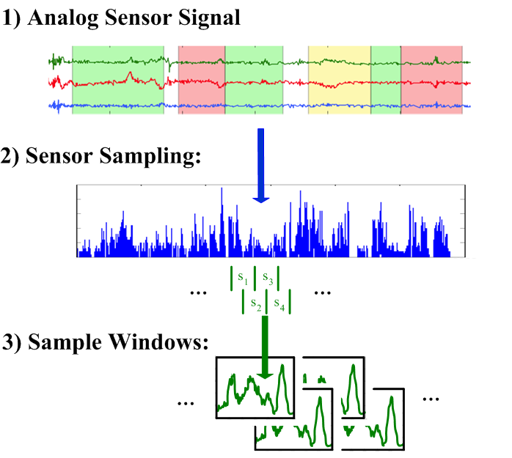
Step 1 – Sample Windows
Specify period of time to be classified
Segment data into windows of that time length
Problem: window length greatly affects classification results!
Nyquist–Shannon sampling theorem
Smallest component frequency B Hz, sample rate > 1/(2B) sufficient
Here: lowest “relevant” frequency C Hz, smallest effective sample window length 1/(2C)
Example: footfalls .5Hz, sample window 2s for context walking
Needed for signal reconstruction → needed for context recognintion?
In practice: empirical evaluated for each application!

Slide 47
Step 2 - Feature Extraction
Goal: extract “important” information for context differentiation (classification), reducing volume and cardinality of values
What information is important? Context and sensor dependent!
Features in time (e.g. mean) and frequency (Fourier Transformation) domain

Slide 48
Step 3 - Classification
Selected features appended to a “feature vector”
This is data that classifier sees
Training: feature vectors augmented with label
Classification: feature vector calculated (1 sample window, live data)
Classifier estimates context occurring
classification=>
Ft.1
Ft.1
…
Ft. n-1
Ft. n
Ft.1
Ft.1
…
Ft. n-1
Ft. n
Label
Ft.1
Ft.1
…
Ft. n-1
Ft. n
???
Label

Slide 49
All together now
Dimensionality Reduction / Increased Abstraction

Slide 50
FEATURE EXTRACTION

Slide 51
Types of Features by Context
Location
GPS, WiFi/BlueTooth fingerprint
Walking speed
Variance of accelerometer
Group affiliation
Cross-correlation, Kullback-Leibler divergence
Context at work
Calendar information
DactyLoc: A minimally geo-referenced WiFi+GSM-fingerprint-based localization method for positioning in urban spaces Kristian Cujia, Martin Wirz, Mikkel Baun Kjærgaard, Daniel Roggen and Gerhard Tröster
Recognition of Crowd Behavior from Mobile Sensors with Pattern Analysis and Graph Clustering Methods Daniel Roggen, Martin Wirz, Dirk Helbing and Gerhard Tröster

Slide 52
Features by Sensor
Wearable context (activity) recognition
Time domain: mean, root mean square, energy, magnitude area (AUC), variance, standard deviation, mean absolute deviation, correlation (between sensors)
Frequency domain: FFT peak(s)
Audio context recognition:
Time domain: zero crossing rate, amplitude fluctuation, amplitude histogram range distribution.
Frequency domain: frequency centroid, bandwidth, spectral roll-off point, fluctuation of amplitude-spectra, subband band energy ratio, cepstral coefficients (CEP), FFT range magnitude
Video: out of scope!
Others: social networks, radio signals, Electroencephalography (EEG), Motion capturing (Kinect), etc.
Radio Frequency Sensor: mostly same as audio

Slide 53
How do I find the right features?
Look in related work for similar applications,
If none available, empiricism and heuristics!!
Brute force approach:
Try them all out, every combination
Optimized:
Feature selection algorithms (see later)
Automatic feature selection for context recognition in mobile devices, Könönen, et al.
Feature Selection and Activity Recognition from Wearable Sensors, Susanna Pirttikangas, Kaori Fujinami, Tatsuo Nakajima

Slide 54
Recognition in Ubiquitous Computing
Low Cost sensing
detect a range of abstract conditions (e.g. human activity, machine condition)
that are related to several physical phenomena
the correlation may not be know from the beginning
Implementation
we opportunistically use sensors that are already there (e.g. your mobile)
or we place simple sensors (nodes) in conveniently reachable places

Slide 55
What is new in Ubicomp/Pervasive/CPS ?
this means we are not in control of
precise position (if at all)
type of sensor
measurement environment
→ indirect sensing may be appropriate: light follows movement
→ more care and "intelligence" for recognition required

Slide 56
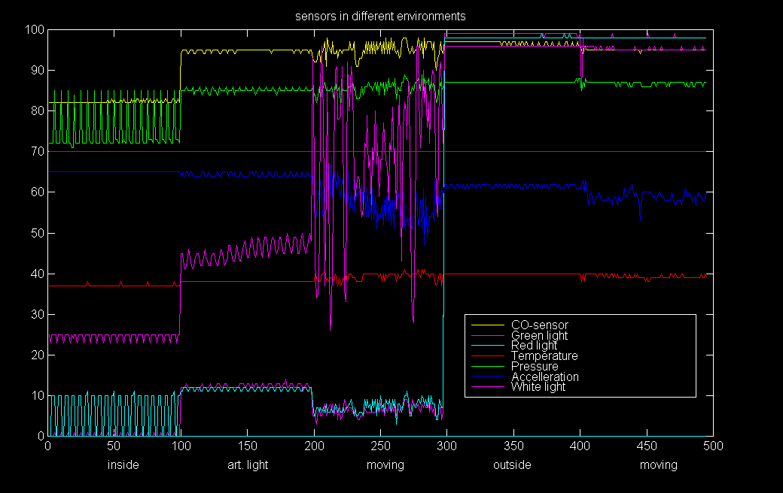
Sensor may be substituted: Light follows movement

Slide 57
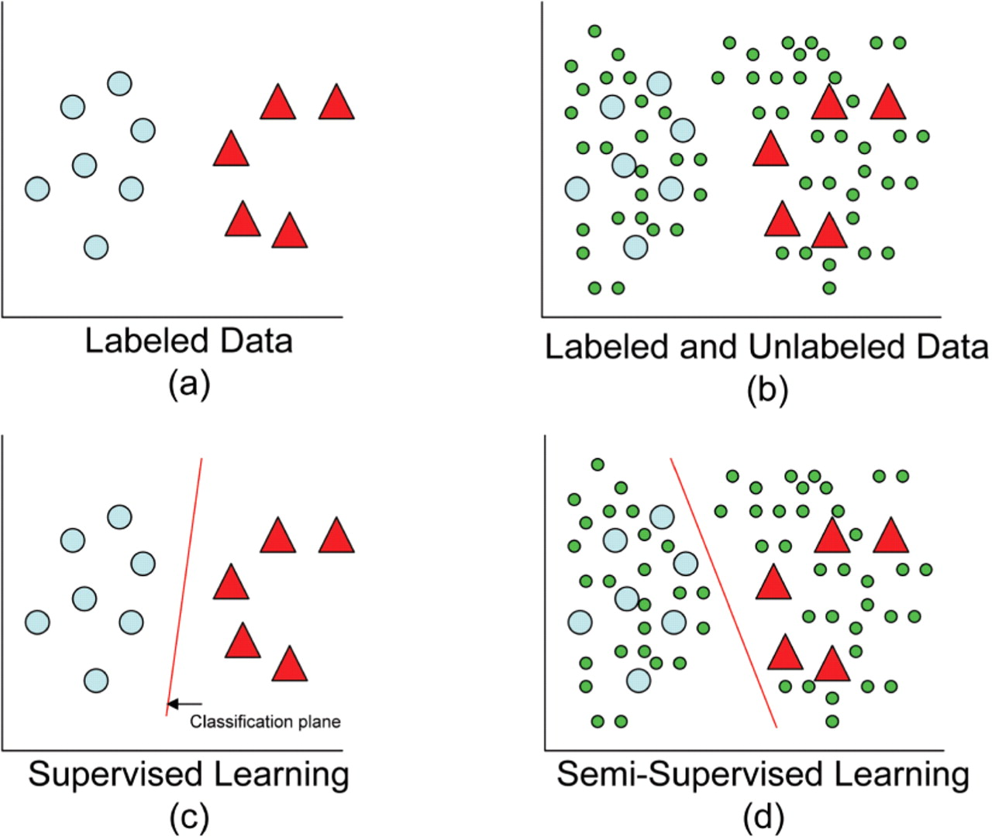
Supervised Machine Learning →Separation function for a feature space

